Slide 1

Towards Inclusive and Practice-Oriented Teacher Education (TIPOTE) in Mozambique

Slide 2
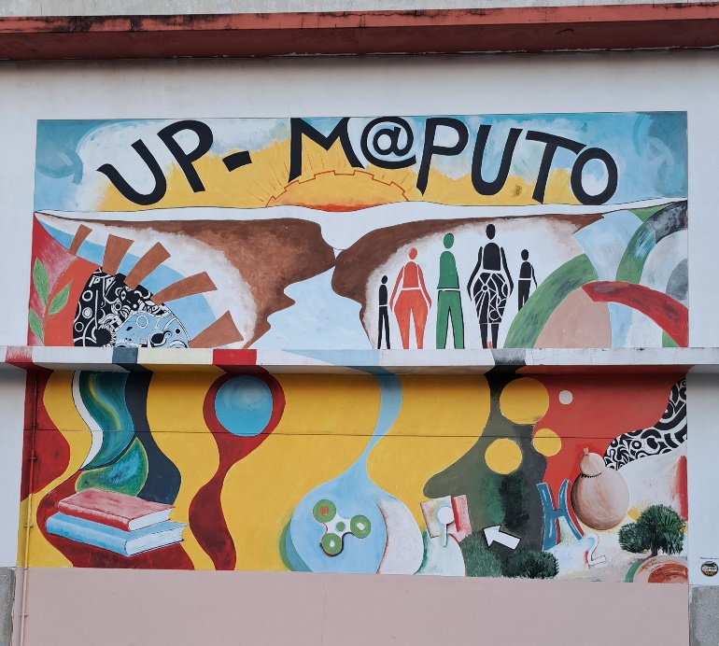
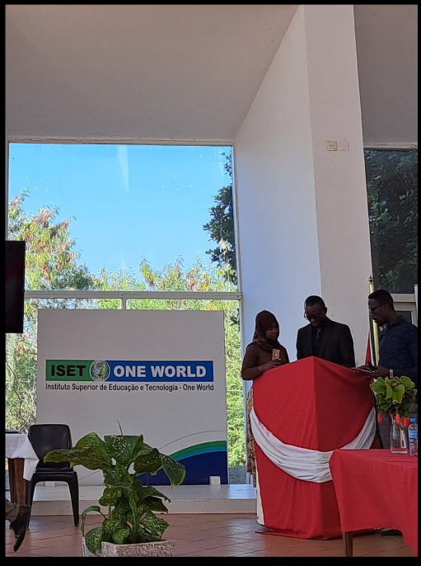
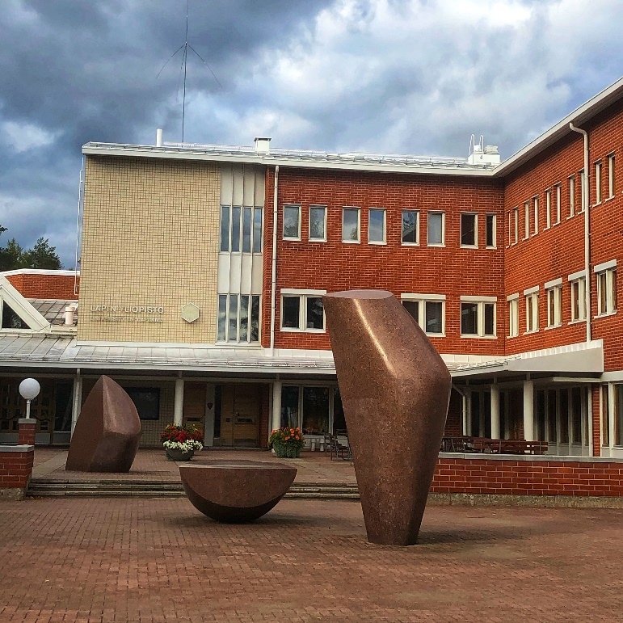
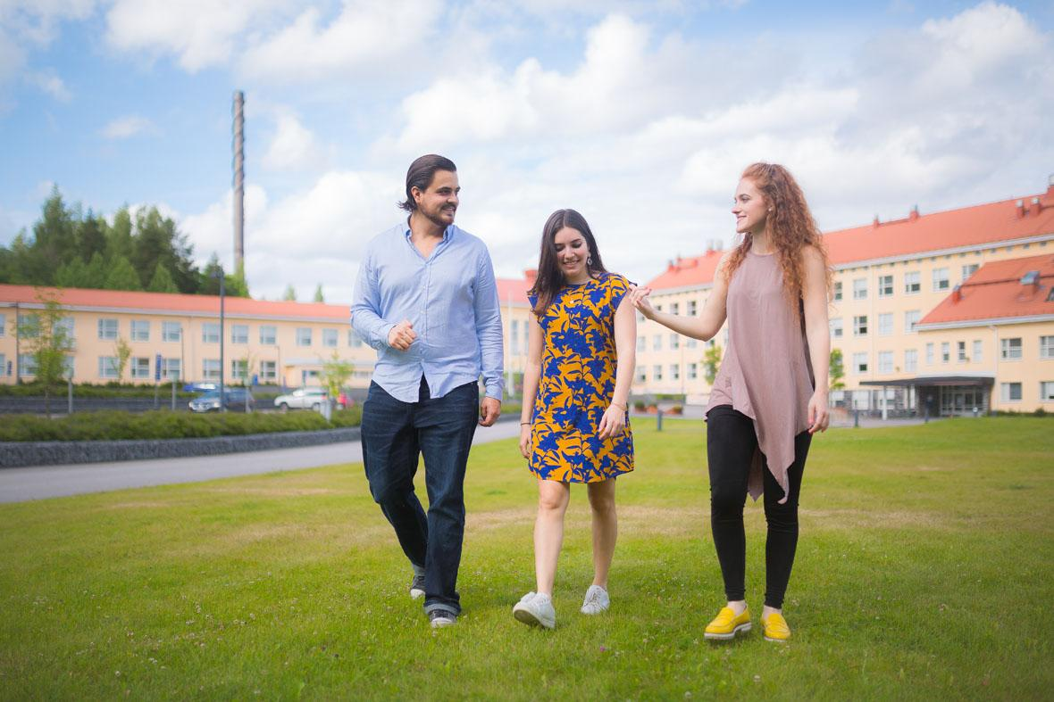
UP-Maputo, Jamk /SPTE, University of Lapland and ISET – One World
Working together already in TEPATE (2020-2024)

Slide 3
IMPACT OBJECTIVE: Strengthened capacity of UP-Maputo & ISET-One World to deliver and develop quality teacher education that provides teacher trainees with improved competences in inclusive education in various Mozambican contexts.
  OUTCOME 1: Strengthened capacity of UP-Maputo and ISET-One World to provide learner-centred inclusive education.
OUTCOME 2: Improved evidence and innovation-based pedagogical practices in UP-Maputo and ISET-One World for learner-centred and practice-oriented inclusive education.

Slide 4
  OUTCOME 1: Strengthened capacity of UP-Maputo and ISET-One World to provide learner-centred inclusive education.
1.Training of Trainers (key experts), staff exchange, study visit, benchmarking
2. Digital tools – hardware, software and pedagogical development
OUTCOME 2: Improved evidence and innovation-based pedagogical practices in UP-Maputo and ISET-One World for learner-centred and practice-oriented inclusive education.
3. Living Labs – innovating and testing inclusive practices in multi-actor teams
4. Tools for inclusive, locally relevant, and practice-oriented STEM education
Dissemination at national level; UP network, ADPP network
Collaboration with UFF/Finland.

Slide 5
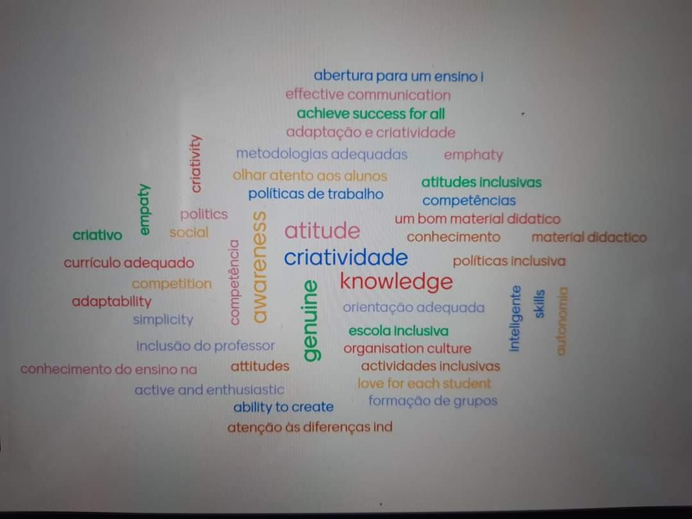
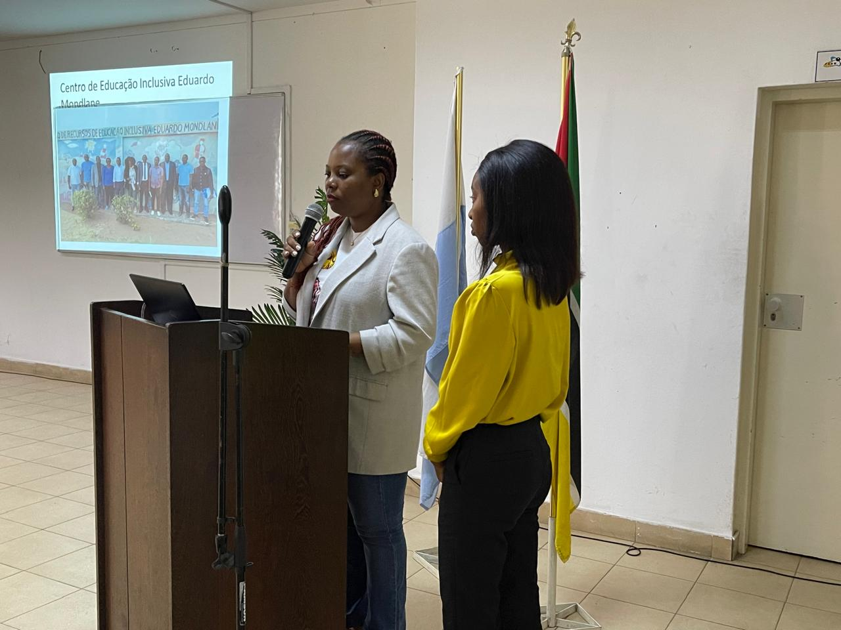
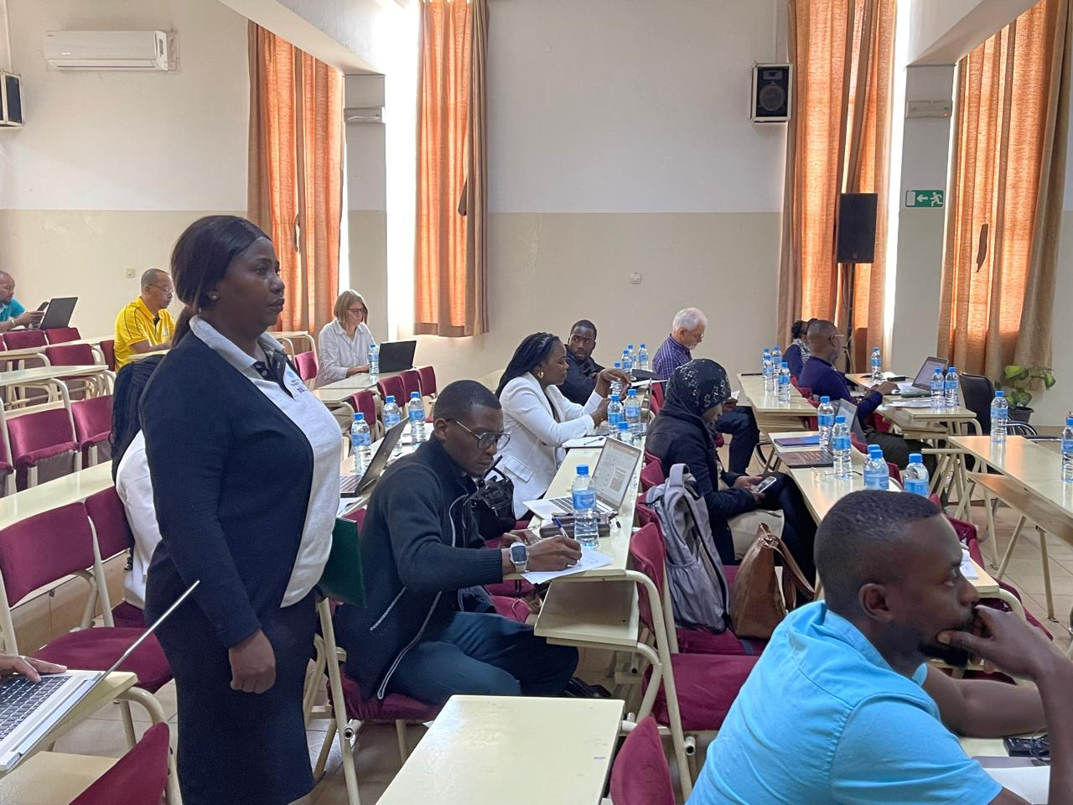
Progress 1-9/2024
Training of Trainers in Mozambique
  Overall plan for 2024-2026
  February 2024 (5 days)
  September 2024 (5 days)

Slide 6
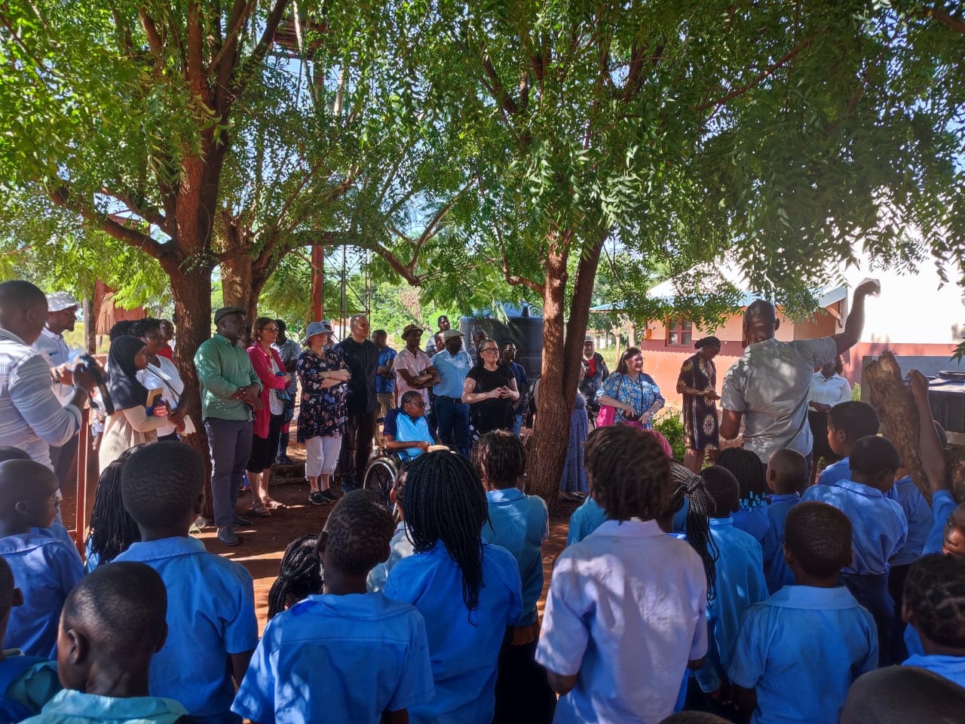
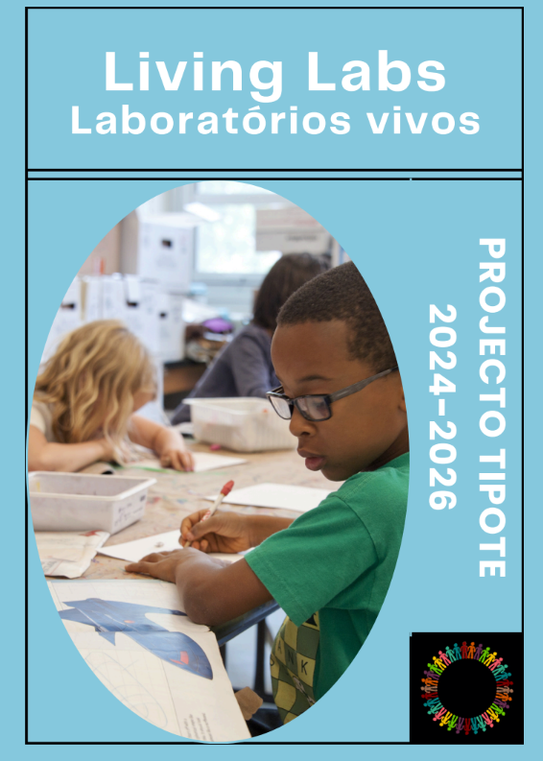
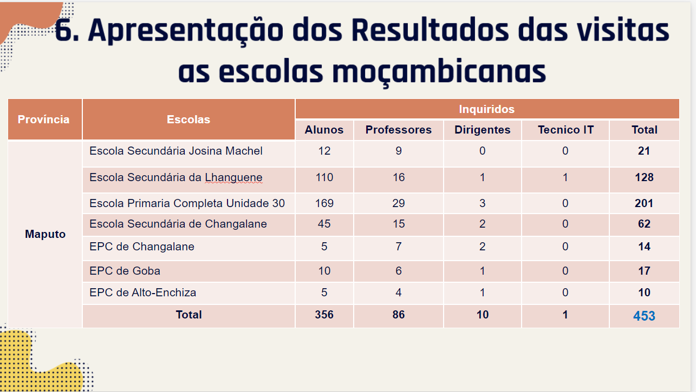
Progress 1-9/2024
Domestic benchmarking in Maputo province, Nampula, Gaza
  June-July 2024
Identification of partnership schools & needs mapping
  July-August 2024
Clarifying and planning the role of Living Labs

Slide 7
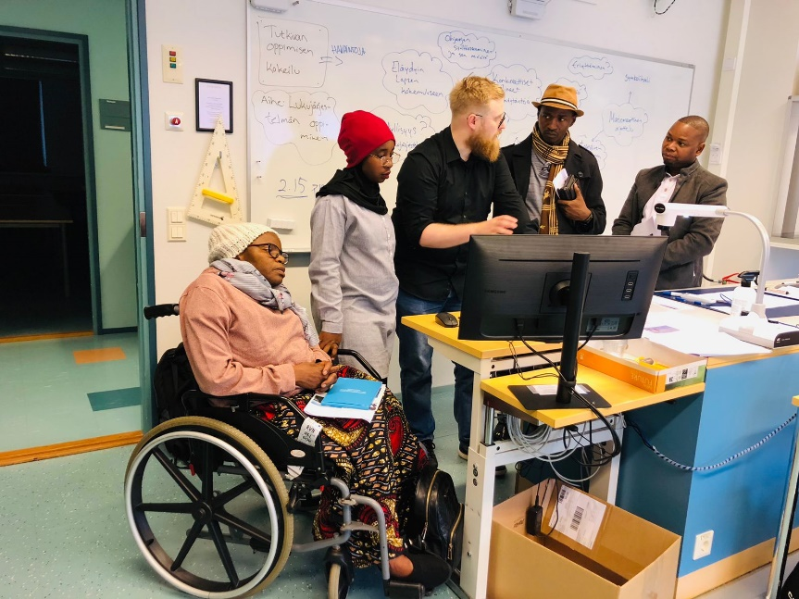
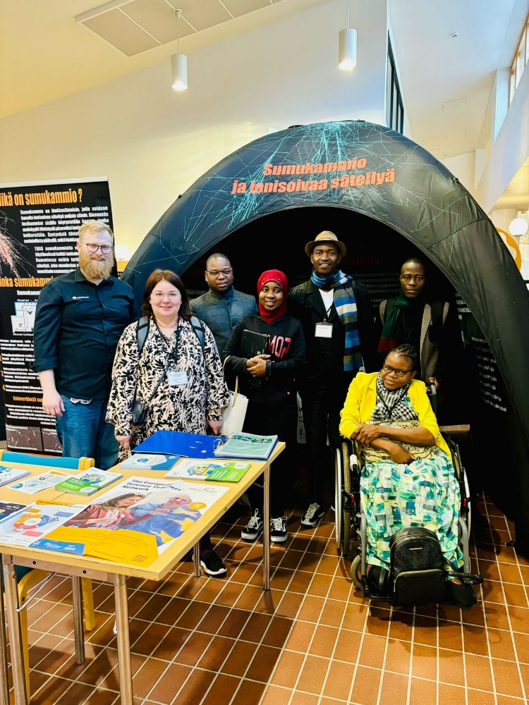
Progress 1-9/2024
Study visit to Finland
  STEM-group (5 people ) in Rovaniemi, Finland
Digital pedagogy and tools
  Investment plans almost ready
  Plans made for digi-pedagogical training and mentoring

Slide 8
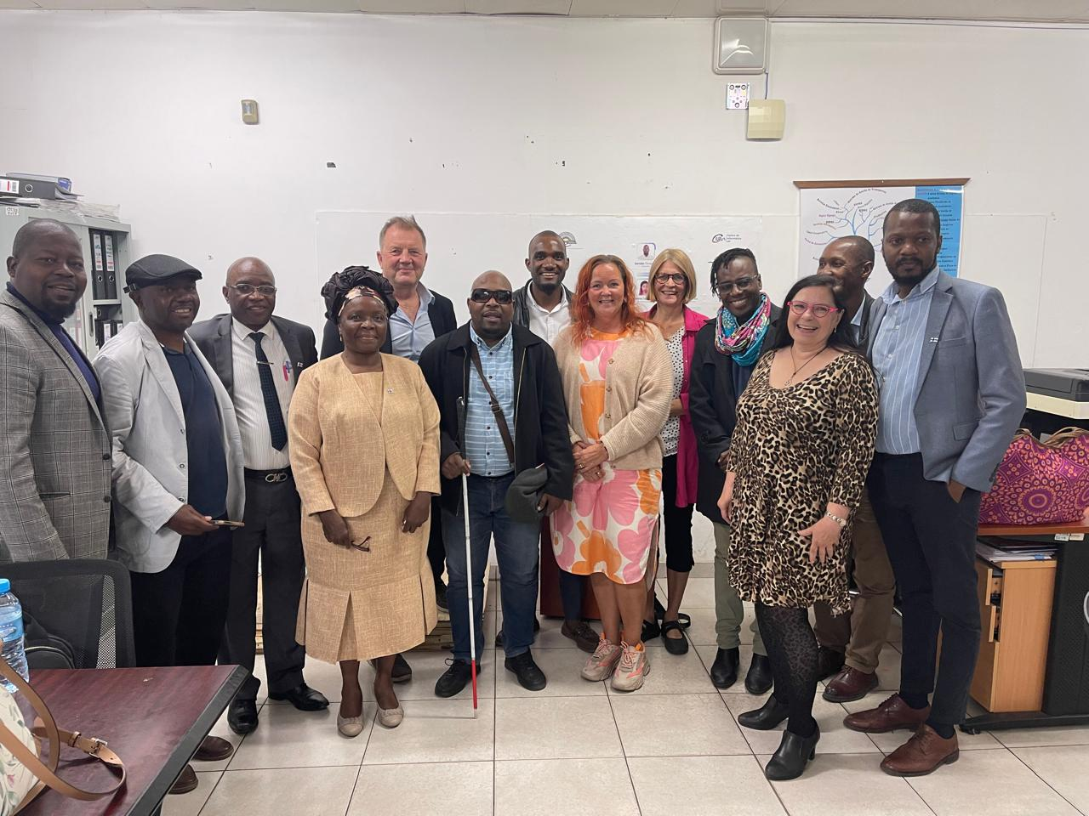
Progress 1-9/2024
Project Board April 2024
Project Advisory Committee (PAC) September 2024
TIPOTE website
  https://www.jamk.fi/en/project/towards-inclusive-and-practice-oriented-teacher-education-tipote

Slide 9
Coordinators
Hanna Laitinen: hanna.laitinen@jamk.fi
Sarita Monjane Henriksen: hmdsarita@gmail.com
Frederico Cossa: fredericocossa42@gmail.com
Outi Kyrö-Ämmälä: outi.kyro-ammala@ulapland.fi

